Slide 1
Computer Network Models
The OSI Model and
TCP/IP Model

Slide 2
CONTENTS
THE OSI MODEL
LAYERS IN THE OSI MODEL
TCP/IP MODEL
ADDRESSING

Slide 3
What is a Protocol?
A network protocol is a formal set of rules, conventions and data structure that governs how computers and other network devices exchange information over a network.
In other words, protocol is a standard procedure and format that two data communication devices must understand, accept and use to be able to talk to each other

Slide 4
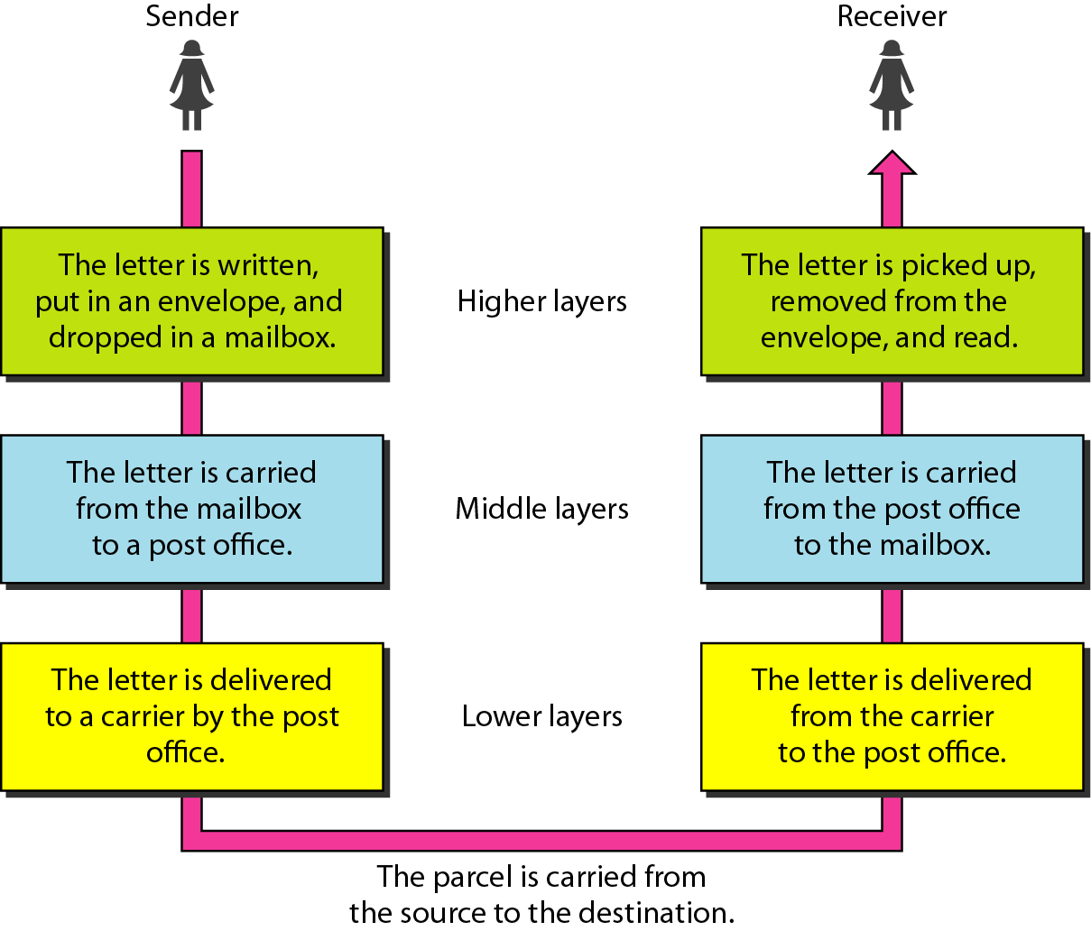
Tasks involved in sending a letter Example of protocols

Slide 5
Why Use Protocol Architecture?
Data communications requires complex procedures
Sender identifies data path/receiver
Systems negotiate preparedness
Applications negotiate preparedness
Translation of file formats
For all tasks to occur, high level of cooperation is required

Slide 6
Network Models
For data communication to take place and two or more users can transmit data from one to other, a systematic approach is required. This approach enables users to communicate and transmit data through efficient and ordered path.
It is implemented using models in computer networks and are known as computer network models.

Slide 7
 | Network Model | Protocol
Definition | Conceptual framework for communication | Set of rules/standards for communication
Purpose | Explains how communication is organized (layers) | Implements communication between devices
Examples | OSI Model, TCP/IP Model | HTTP, TCP, IP, Ethernet, Wi-Fi
Nature | Theoretical / conceptual | Practical / implemented
Analogy | Blueprint / architecture | Actual language or instructions used

Slide 8
Networking models
Computer network models are responsible for establishing a connection among the sender and receiver and transmitting the data in a smooth manner respectively.
There are two computer network models i.e. OSI Model and TCP/IP Model on which the whole data communication process relies.

Slide 9
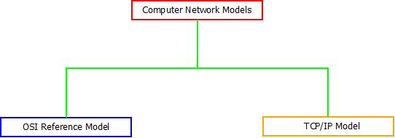
Networking models

Slide 10
The OSI Reference Model
OSI stands for “Open System Interconnection”
the name of this reference model was given by an organization known as “International Organization for Standardization”
It is not a protocol
It is a model

Slide 11
OSI (Open system Interconnection)
Open system is a set of protocols that allows any two different systems to communicate regardless of their underlying architecture.
OSI model is called as “Open Source” because of its “fit anywhere” ability.
Any connection can be established using the OSI model unless and until any protocols are not used as OSI model does not support protocol establishment.

Slide 12

ISO is the organization. OSI is the model.

Slide 13
2.1
THE
OSI
MODEL

Slide 14
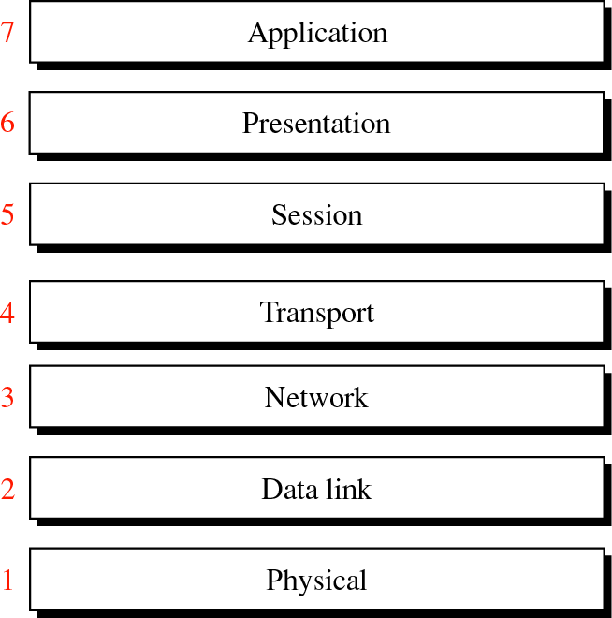
OSI Model
Figure 2-1
The functionalities are different for each layer and thus when combined together forms the OSI Model. There are in total seven layers in general purpose OSI model.

Slide 15
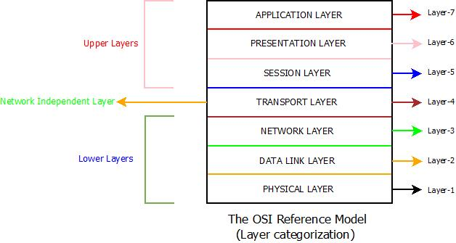
OSI Model
Figure 2-1
The seven layers of OSI model are further categorized into Upper Layers, Network Independent Layer and Lower Layers.
Physical Layer, Data link Layer and Network Layer are categorized as Lower Layers.
Transport Layer as Network Independent Layer and
Session Layer, Presentation Layer, Application Layer as Upper Layers.

Slide 16
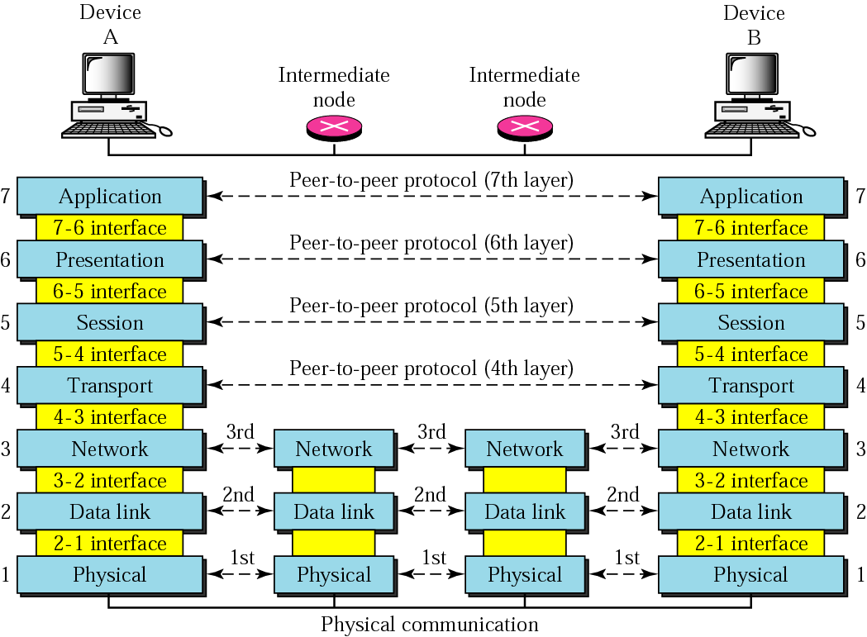
Figure 2-2
Architecture of OSI Model

Slide 17
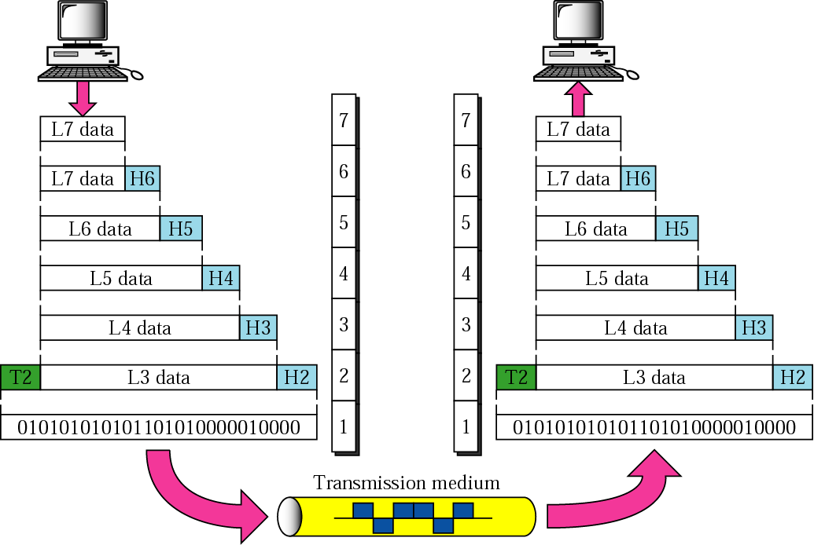
Figure 2-3
Data exchange using the OSI model

Slide 18
2.2
LAYERS
IN
THE
OSI
MODEL

Slide 19
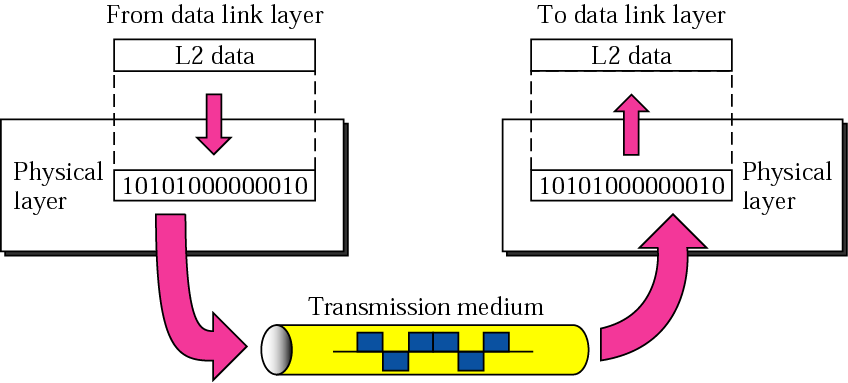
Figure 2-4
Physical Layer
The Physical Layer is the bottom most layer and is associated with electrical, mechanical and functional aspects of the transmission media for information and receiving over internet.

Slide 20
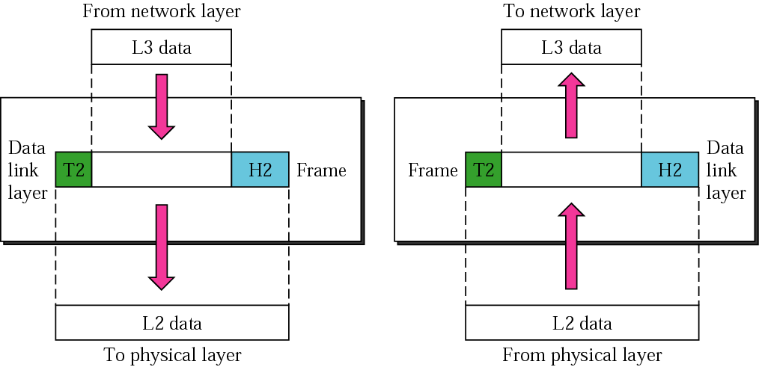
Figure 2-5
Data Link Layer
The Data Link Layer is second from bottom and comes under the lower layer category. It ensures that the data framing. Error detection and control are enabled in this layer.

Slide 21
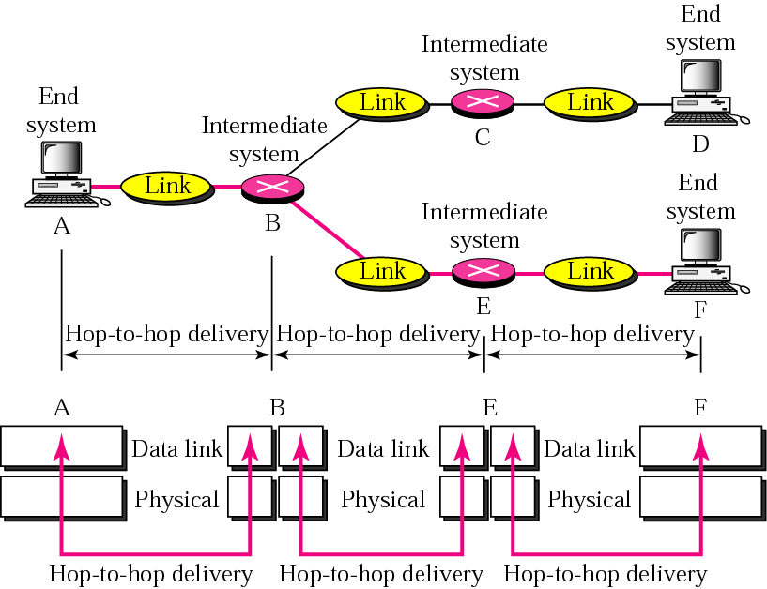
Figure 2-6
Node-to-node delivery
(Data link layer)

Slide 22
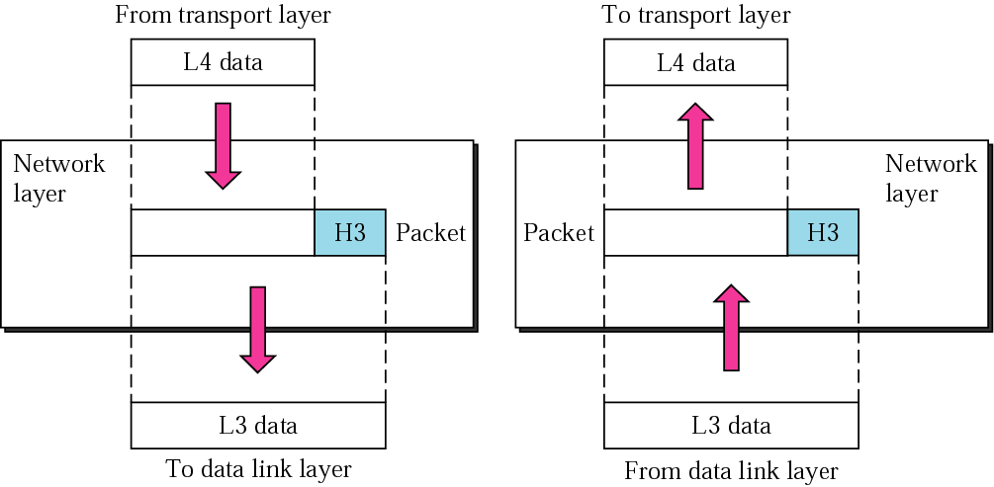
Figure 2-7
Network Layer
The Network Layer is third from bottom in OSI model and is responsible for establishing data communication channel between multiple networks or devices or hosts or nodes.it controls the operation of the subnet and routing packet from source to destination

Slide 23
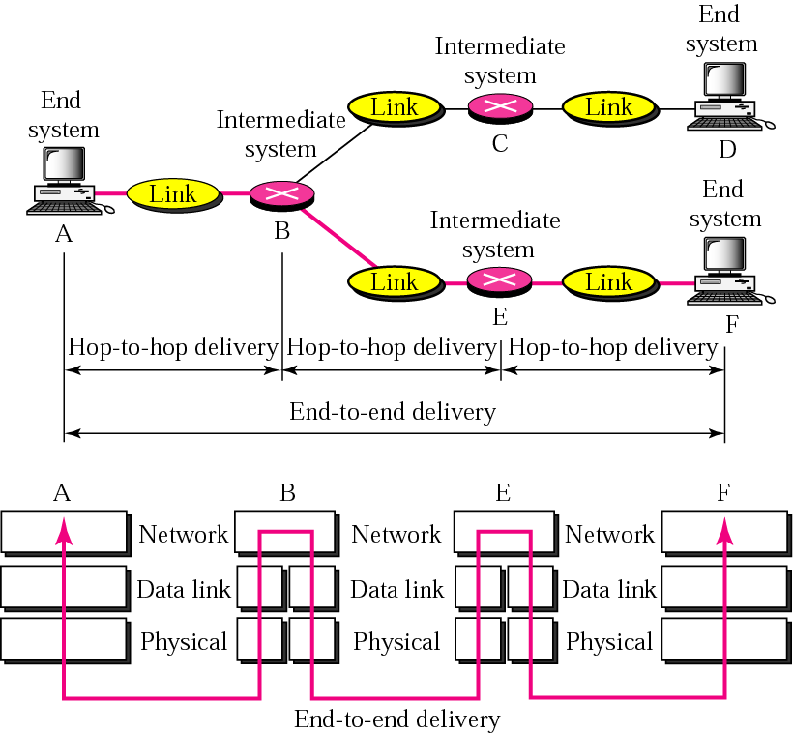
Figure 2-8
End-to-end delivery
Network layer is responsible for End-to-End Delivery

Slide 24
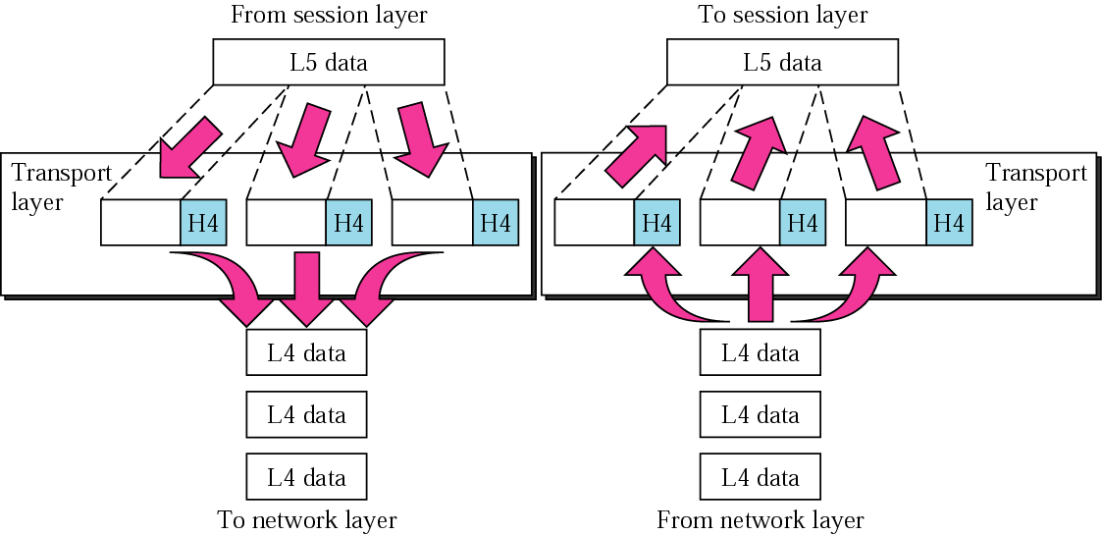
Figure 2-9
Transport Layer
Transport Layer is the middle most layer in OSI model and it acts as Network Independent Layer.
Transport layer is responsible for reliable process-to-process delivery

Slide 25
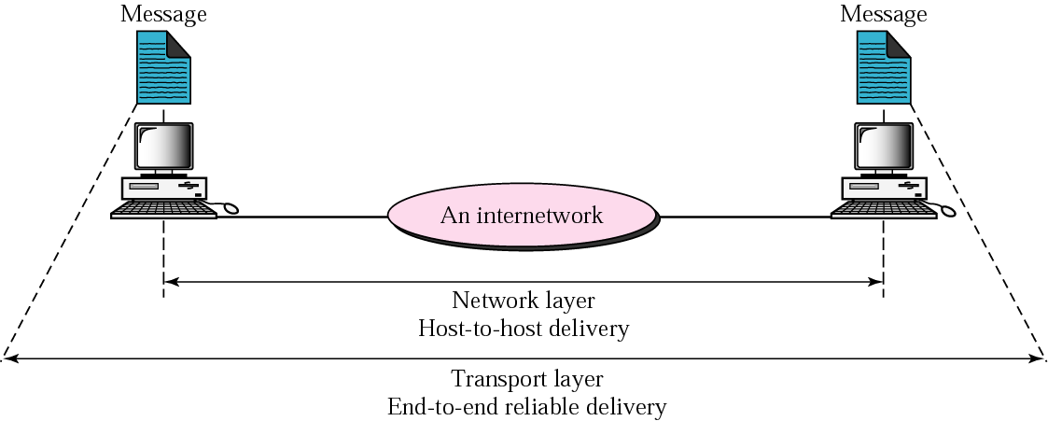
Figure 2-10
Reliable end-to-end delivery of a message

Slide 26
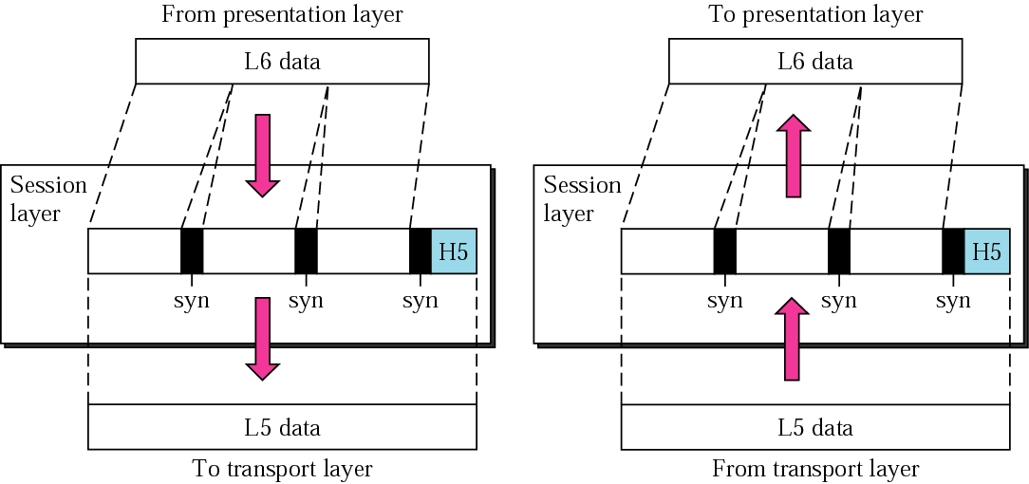
Figure 2-11
Session Layer
Session Layer is the fifth layer of OSI model and it provides appropriate sessions between users and entities.
It can be skipped too if not required.
For example : Login Sessions in online banking.

Slide 27
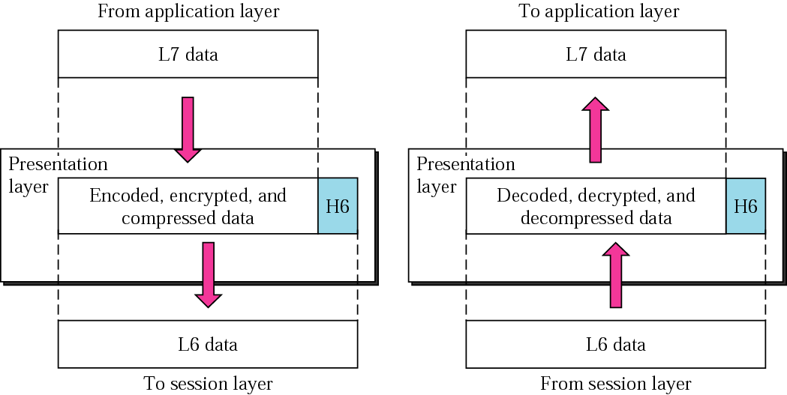
Figure 2-12
Presentation Layer
This is the sixth layer of OSI model and it provides appropriate representation of data through various data presentation techniques.

Slide 28
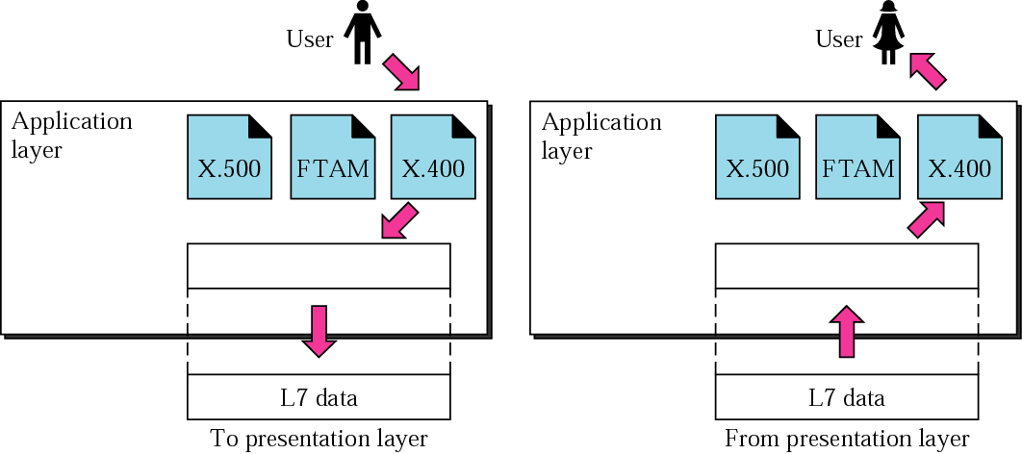
Figure 2-13
Application Layer
Application Layer is the topmost layer of the OSI model and has the responsibility for providing interface between various users and application.

Slide 29
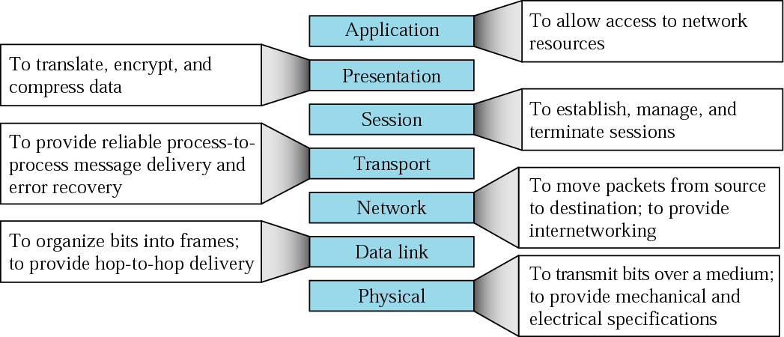
Figure 2-14
Summary of layers

Slide 30
+----------------------+
| 7. Application | (User services: HTTP, FTP, Email)
+----------------------+
| 6. Presentation | (Encryption, Compression, Translation)
+----------------------+
| 5. Session | (Session management, synchronization)
+----------------------+
| 4. Transport | (TCP, UDP, reliable delivery)
+----------------------+
| 3. Network | (IP, Routing, logical addressing)
+----------------------+
| 2. Data Link | (MAC address, frames, error detection)
+----------------------+
| 1. Physical | (Cables, Wi-Fi, signals, bits)
+----------------------+

Slide 31
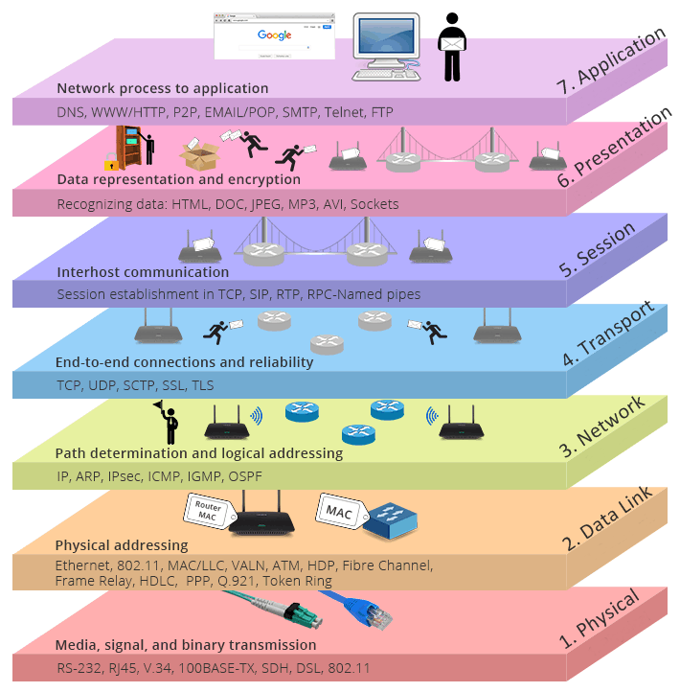
Visualization of OSI layers

Slide 32
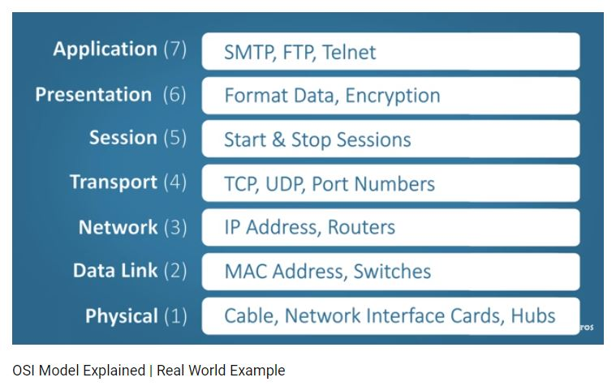
OSI layers Key-term
Notes:
Added later.

Slide 33
TCP/IP
Model

Slide 34
TCP/IP Protocol Suite
Apart from OSI Model, another computer network models which is widely used is TCP/IP Protocol Suite.
Notes:
Added later.

Slide 35
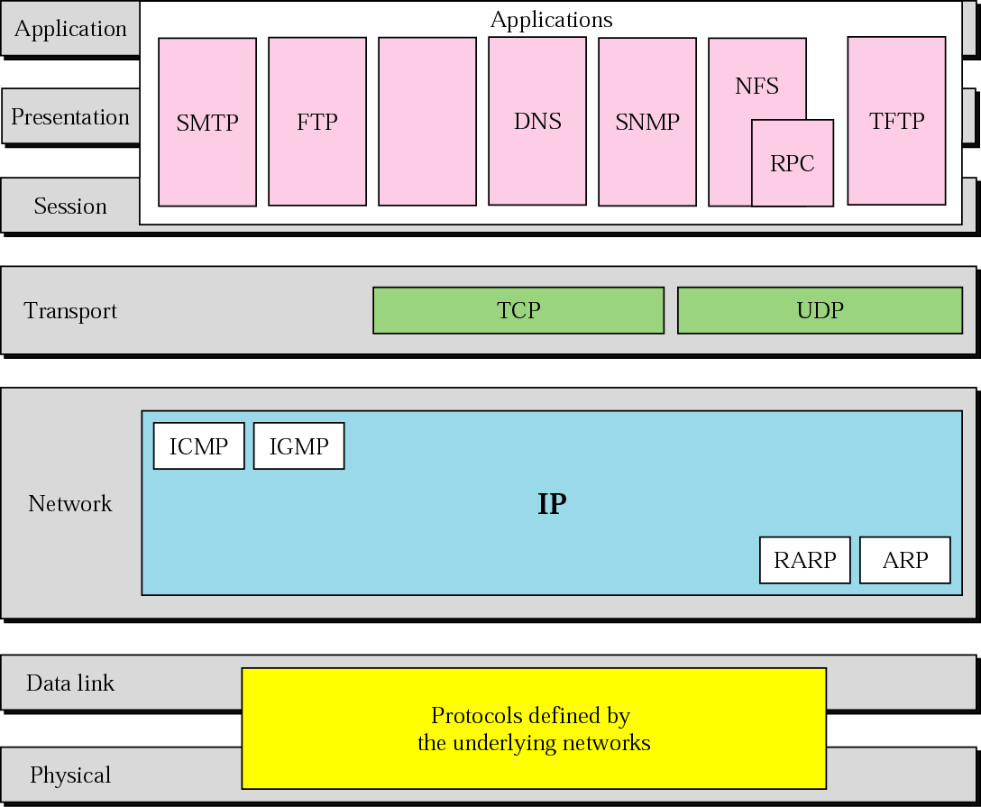
Figure 2-15
TCP/IP and OSI model

Slide 36
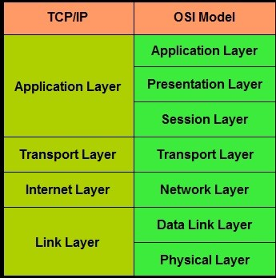
TCP/IP and OSI model
Notes:
Added later.

Slide 37
2.4
ADDRESSING

Slide 38
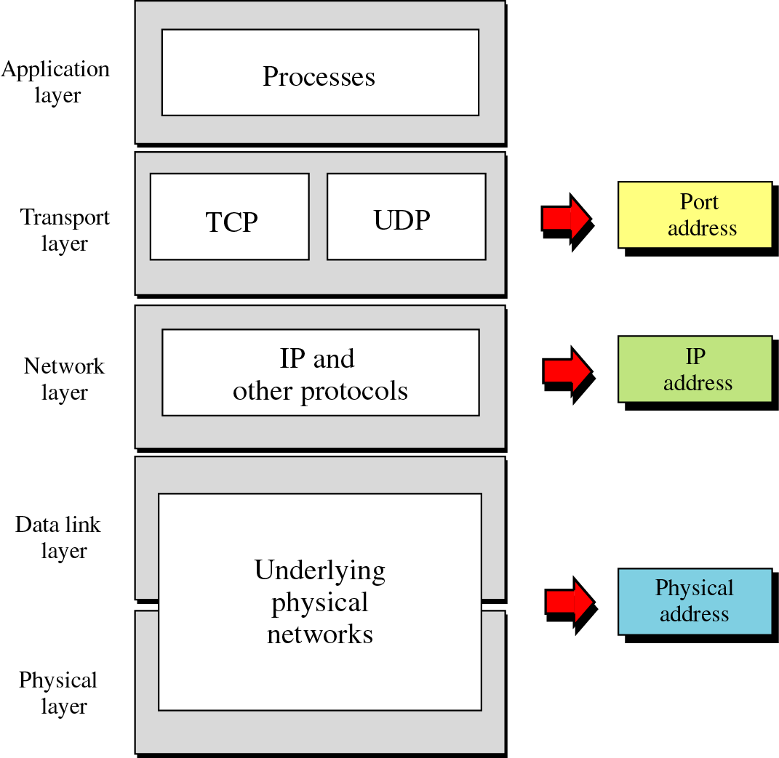
Figure 2-17
Relation-
ship
of
layers
and
addresses
in TCP/IP

Slide 39
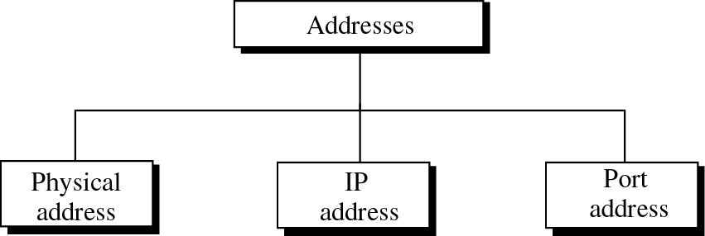
Figure 2-16
Addresses in TCP/IP

Slide 40
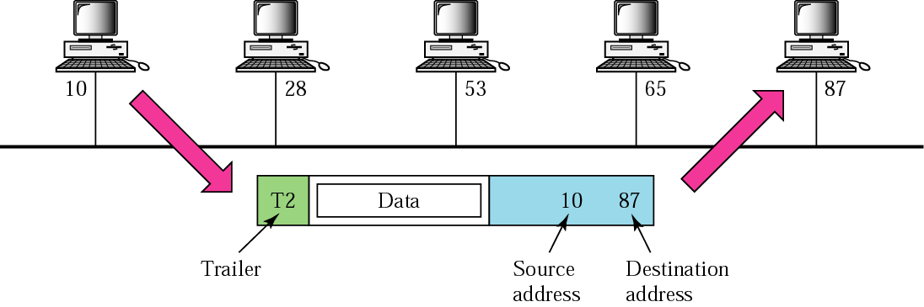
Figure 2-18
Physical addresses

Slide 41
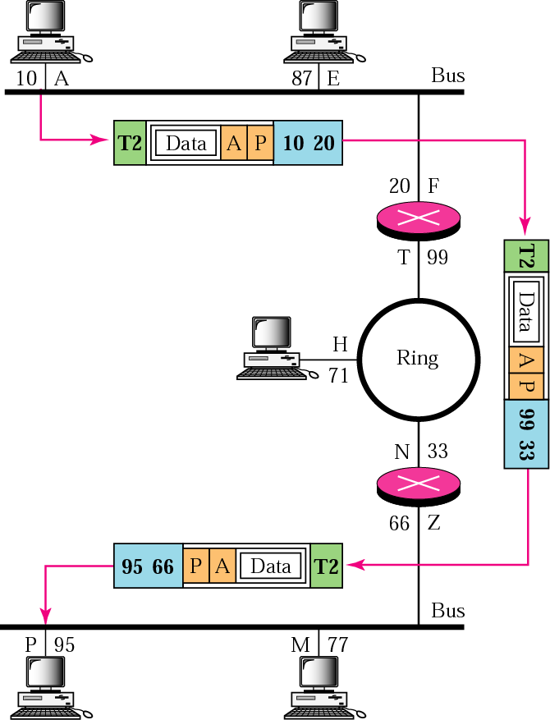
Figure 2-19
IP addresses

Slide 42
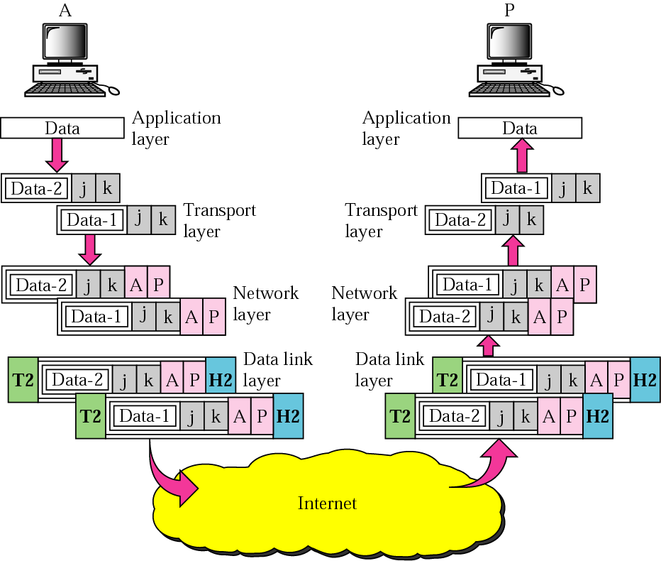
Figure 2-20
Port addresses

Slide 43
Advantages Of OSI Model
The OSI Model being one of the most widely used computer network models does posses some major advantages which makes it so popular. These are :
Each layer has its definite structure and functionality which makes OSI model simple and easy to use.
It is a general purpose reference model that can be used for data communication.
Connection oriented and connection-less services are supported.
Connection between any type of devices or host or hardware or software is possible.

Slide 44
Disadvantages Of OSI Model
Because of its inability to fit protocols, this model was replaced by TCP/IP Internet Model.
Session and Presentation layers does not provide high end functionalities and are not of much use as compared to other layers.
Connection oriented and connection-less services are supported.

Slide 45
H.W
Difference Between OSI model and TCP/IP model

